Slide 1

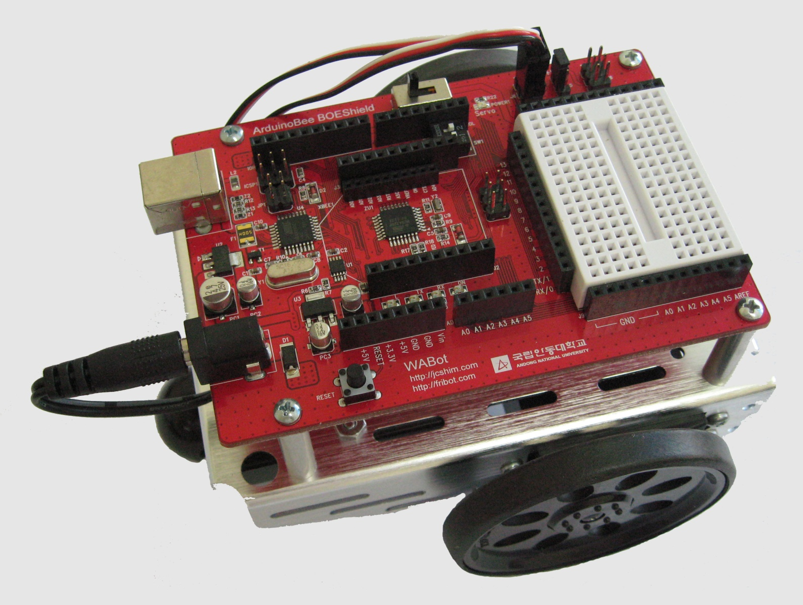
빛으로 로봇 조종 (3)
컴퓨터소프트웨어공학과
IoT프로그래밍

Slide 2
ndShade 출력
void setup() // Built-in initialization block
{
tone(4, 3000, 1000); // Play tone for 1 second
delay(1000); // Delay to finish tone
Serial.begin(9600); // Set data rate to 9600 bps
}
void loop() // Main loop auto-repeats
{
float tLeft = float(rcTime(8)); // Get left light & make float
float tRight = float(rcTime(6)); // Get right light & make float
float ndShade; // Normalized differential shade
ndShade = tRight/(tLeft+tRight)-0.5; //Calculate it and subtract 0.5
자료출처: Parallax.com

Slide 3
// Display heading
Serial.println("tLeft ndShade tRight");
Serial.print(tLeft); // Display tLeft value
Serial.print(" "); // Display spaces
Serial.print(ndShade); // Display ndShade value
Serial.print(" "); // Display more spaces
Serial.println(tRight); // Display tRight value
Serial.println(' '); // Add an extra newline
delay(1000); // 1 second delay
}
long rcTime(int pin) // rcTime measures decay at pin
{
pinMode(pin, OUTPUT); // Charge capacitor
digitalWrite(pin, HIGH); // ..by setting pin ouput-high
delay(5); // ..for 5 ms
pinMode(pin, INPUT); // Set pin to input
digitalWrite(pin, LOW); // ..with no pullup
long time = micros(); // Mark the time
while(digitalRead(pin)); // Wait for voltage < threshold
time = micros() - time; // Calculate decay time
return time; // Returns decay time
}

Slide 4
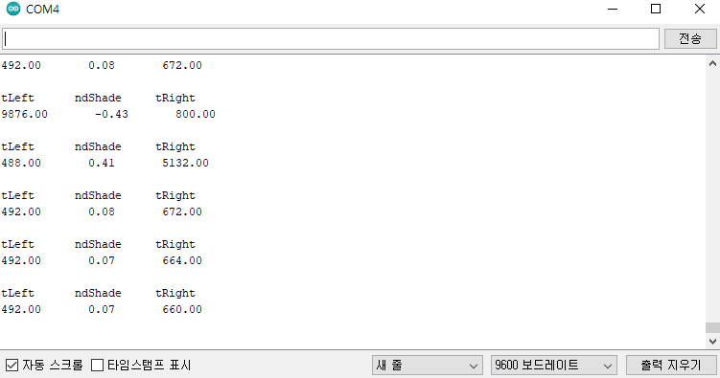
ndShade 출력
자료출처: Parallax.com

Slide 5

ndShade 출력
자료출처: Parallax.com

Slide 6
ndShade
항상 0과 1 사이값
(2) tRight >> 0, tLeft = 0 : ndShade = 1
(3) tRight = 0, tLeft >> 0 : ndShade = 0
(4) tRight = tLeft : ndShade = 0.5
(5) ndShade < 0.5 : tRight < tLeft
(6) ndShade > 0.5 : tRight > tLeft
(7) ndShade - 0.5 = ?

Slide 7
ABOT 유도 스케치
#include <Servo.h> // Include servo library
Servo servoLeft; // Declare left and right servos
Servo servoRight;
void setup() // Built-in initialization block
{
tone(4, 3000, 1000); // Play tone for 1 second
delay(1000); // Delay to finish tone
servoLeft.attach(13); // Attach left signal to pin 13
servoRight.attach(12); // Attach right signal to pin 12
}
void loop() // Main loop auto-repeats
{
float tLeft = float(rcTime(8)); // Get left light & make float
float tRight = float(rcTime(6)); // Get right light & make float
float ndShade; // Normalized differential shade
ndShade = tRight/(tLeft+tRight)-0.5; //Calculate it and subtract 0.5
int speedLeft, speedRight; // Declare speed variables
자료출처: Parallax.com

Slide 8
if (ndShade > 0.0) // Shade on right?
{ // Slow down left wheel
speedLeft = int(200.0 - (ndShade * 1000.0));
speedLeft = constrain(speedLeft, -200, 200);
speedRight = 200; // Full speed right wheel
}
else // Shade on Left?
{ // Slow down right wheel
speedRight = int(200.0 + (ndShade * 1000.0));
speedRight = constrain(speedRight, -200, 200);
speedLeft = 200; // Full speed left wheel
}
maneuver(speedLeft, speedRight, 20); // Set wheel speeds
}
long rcTime(int pin) // rcTime measures decay at pin
{
pinMode(pin, OUTPUT); // Charge capacitor
digitalWrite(pin, HIGH); // ..by setting pin ouput-high
delay(5); // ..for 5 ms
pinMode(pin, INPUT); // Set pin to input
digitalWrite(pin, LOW); // ..with no pullup
long time = micros(); // Mark the time
while(digitalRead(pin)); // Wait for voltage < threshold
time = micros() - time; // Calculate decay time
return time; // Returns decay time
}

Slide 9
// maneuver function
void maneuver(int speedLeft, int speedRight, int msTime)
{
servoLeft.writeMicroseconds(1500+speedLeft);// Set Left servo speed
servoRight.writeMicroseconds(1500 - speedRight);
//Set right servo speed
if(msTime==-1) // if msTime = -1
{
servoLeft.detach(); // Stop servo signals
servoRight.detach();
}
delay(msTime); // Delay for msTime
}
자료출처: Parallax.com

Slide 11
ABOT 유도 스케치
(1) 로봇의 우측 측면으로 그림자가 감지
(2) ABOT이 어둠으로부터 멀어지게 회전하도록 왼쪽 바퀴 속도를 낮춤
(3) ndShade * 1000.0는 200으로부터 차감
(4) int(200.0–(ndShade×1000.0)는 유동 소수점 해답을 정수형으로 바꿈
(5) speedLeft가 제한구역을 벗어나지 않도록 constrain 함수를 사용
if (ndShade > 0.0) // Shade on right?
{ // Slow down left wheel
speedLeft = int(200.0 - (ndShade * 1000.0));
speedLeft = constrain(speedLeft, -200, 200);
speedRight = 200; // Full speed right wheel
}

Slide 12
ABOT 유도 스케치 실습과제 1
ndShade 에 따른 speedLeft와 speedRight 값을 출력

Slide 13
ABOT 유도 스케치 실습과제 1
void setup() // Built-in initialization block
{
tone(4, 3000, 1000); // Play tone for 1 second
delay(1000); // Delay to finish tone
Serial.begin(9600); // Set data rate to 9600 bps
}
void loop() // Main loop auto-repeats
{
float tLeft = float(rcTime(8)); // Get left light & make float
float tRight = float(rcTime(6)); // Get right light & make float
float ndShade; // Normalized differential shade
ndShade = tRight/(tLeft+tRight)-0.5; //Calculate it and subtract 0.5
int speedLeft, speedRight; // Declare speed variables
자료출처: Parallax.com

Slide 14
if (ndShade > 0.0) // Shade on right?
{ // Slow down left wheel
speedLeft = int(200.0 - (ndShade * 1000.0));
speedLeft = constrain(speedLeft, -200, 200);
speedRight = 200; // Full speed right wheel
}
else // Shade on Left?
{ // Slow down right wheel
speedRight = int(200.0 + (ndShade * 1000.0));
speedRight = constrain(speedRight, -200, 200);
speedLeft = 200; // Full speed left wheel
}
Serial.print(speedLeft, DEC); // Display speedLeft
Serial.print(" "); // Spaces
Serial.print(ndShade, DEC); // Display ndShade
Serial.print(" "); // More spaces
Serial.println(speedRight, DEC); // Display speedRight}
delay(1000); // 1 second delay
}
long rcTime(int pin) // rcTime measures decay at pin
{
pinMode(pin, OUTPUT); // Charge capacitor
digitalWrite(pin, HIGH); // ..by setting pin ouput-high
delay(5); // ..for 5 ms
pinMode(pin, INPUT); // Set pin to input
digitalWrite(pin, LOW); // ..with no pullup
long time = micros(); // Mark the time
while(digitalRead(pin)); // Wait for voltage < threshold
time = micros() - time; // Calculate decay time
return time; // Returns decay time
}

Slide 15
ABOT 유도 스케치 실습과제 2
과제1. 다음처럼 하려면 스케치를 어떻게 수정해야 할 지를 생각하여 적으세요.
1) ABOT이 더 민감하게 하려면?
2) ABOT이 덜 민감하게 하려면?
3) ABOT이 어둠을 쫓아가도록 하려면?

Slide 16
ABOT 유도 스케치 실습과제 3
ABOT이 밝은쪽을 쫓아가서 빛에서 멈추도록
(과제2. 동영상과 스케치 제출)

Slide 17


